Slide 1


Reshma Karkal
21.01.2026

Slide 2

Outline
Executive Summary
Introduction
Methodology
Results
Conclusion
Appendix

Slide 3
Executive Summary
Summary of methodologies
Data collection
Data wrangling
EDA with data visualization
EDA with SQL
Building an interactive map with Folium
Building a Dashboard with Plotly Dash
Predictive analysis (Classification)
Summary of all results
EDA results
Interactive analytics
Predictive analysis

Slide 4
Introduction
Project Background and Context:
In this capstone project, we aim to predict the successful landing of the Falcon 9 first stage. SpaceX advertises rocket launches at a significantly lower cost compared to other providers, largely due to their ability to reuse the first stage of the rocket. By accurately predicting landing success, we can estimate launch costs and provide valuable insights for companies bidding against SpaceX.
Problems We Want to Find Answers To:
What factors influence the successful landing of the Falcon 9 first stage?
How can we accurately predict the landing outcome using machine learning models?
Which machine learning model performs best in predicting the landing success?

Slide 5

Section 1

Slide 6
Methodology
Executive Summary: This project employs a comprehensive approach to predict the successful landing of the Falcon 9 first stage, incorporating data collection, processing, exploratory analysis, interactive visualizations, and predictive modeling.
Data collection methodology:
SpaceX Open-Source Rest API
Web Scraping from Wikipedia page ‘List of Falcon 9 and Falcon Heavy Launches’
Perform data wrangling
Transforming categorical data using One Hot Encoding for machine learning algorithms and removing any empty or unnecessary information from the dataset.
Perform exploratory data analysis (EDA) using visualization and SQL
Perform interactive visual analytics using Folium and Plotly Dash
Perform predictive analysis using classification models
Logistic Regression, K-Nearest Neighbors, Support Vector Machines, and Decision Tree models have been developed to determine the most effective classification method.

Slide 7
Data Collection
The data sets are collected using 2 methods:
Request to the SpaceX API
Gathered SpaceX's past launch data via their open-source API.
Retrieved and processed this data with GET request.
Ensured the data included only Falcon 9 launches.
Filled in missing payload weights from secret missions with average values.
Web Scraping
Requested past Falcon 9 and Falcon Heavy launch data from Wikipedia's relevant page.
Accessed the Falcon 9 Launch page via its direct Wikipedia link.
Extracted all the column names from the HTML table.
Parsed and transformed the table into a Pandas data frame suitable for analysis.

Slide 8
Data Collection
Step 1: SpaceX API Request
Initiate API Request
Fetch Launch Data
Store Data Locally
Step 2: Web Scraping Wikipedia
Extract HTML Table
Parse with BeautifulSoup
Convert to DataFrame
Step 3: Data Integration
SpaceX API
Data & Wikipedia
Data
Final Integrated
Data
Merge Datasets
8

Slide 9
Data Collection – SpaceX API
Step 1: Initiate API Request
Use Python's `requests` library to connect to the SpaceX API.
Endpoint: `https://api.spacexdata.com/v4/launches`
Fetch Launch Data (launch dates, sites, payloads, outcomes, etc.)
Initiate API Request (requests.get)
Step 2: Parse API Response
Convert API response from JSON to a Python
dictionary.
Extract relevant fields: launch date, launch site,
payload mass, rocket type, outcome.
Extract Relevant Fields (date, site,
payload, rocket, outcome)
Parse JSON
Response (response.json())
Step 3: Store Data Locally
Save extracted data into a pandas DataFrame.
Store the DataFrame locally for further processing.
Store Data in
DataFrame (pandas.DataFrame)
Save Data Locally (data.csv or
database)
GitHub URL: Module 01-1 Hands-on Lab Complete the Data Collection API Lab.ipynb

Slide 10
Data Collection - Scraping
Step 1: Initiate Web Scraping
Use Python's `requests` library to fetch the HTML content of the Wikipedia page.
Target URL:
`https://en.wikipedia.org/wiki/List_of_Falcon_9_ and_Falcon_Heavy_launches`
Step 2: Parse HTML Content
Use `BeautifulSoup` to parse the HTML content.
Extract the HTML table containing Falcon 9 launch records.
Step 3: Convert to DataFrame
Convert the extracted HTML table into a pandas DataFrame.
Clean and format the DataFrame, ensuring data consistency.
Request Web
Page (requests.get)
Parse HTML Content
(BeautifulSoup)
Convert HTML Table to DataFrame (pandas.DataFrame)
Extract Launch Records (HTML table)
Clean and Format Data (drop nulls,
standardize columns)
GitHub URL: Module 01-2 Hands-on Lab Complete the Data Collection with Web Scraping lab.ipynb

Slide 11
Data Wrangling
Overview: Data wrangling involves cleaning, transforming, and organizing raw data into a structured format suitable for analysis.
Step 1: Data Cleaning
Identify and fill or remove missing values in the dataset.
Use appropriate imputation techniques or drop rows/columns with excessive missing data.
Step 2: Data Transformation
Convert data types to appropriate formats (e.g., date-time, numerical).
Standardize text (e.g., lowercase, remove whitespace).
Create new features from existing data (e.g., extract year from date).
Normalize/scale numerical features to ensure consistency.
Step 3: Data Integration
Merge datasets collected from different sources (API, web scraping) into a single cohesive dataset.
Ensure consistent column names and data formats across datasets.
Step 4: Data Validation
Check for duplicate records and remove them.
Verify the accuracy and consistency of data entries.
GitHub URL: Module 01-3 Hands-on Lab Data wrangling.ipynb

Slide 12
Data Wrangling
Identify Missing
Values (pandas.isnull)
Ensure Consistency (align columns, data types)
Check for Duplicates (pd.duplicated, drop)
Impute/Remove Missing Data (fillna/dropna)
Merge DataFrames (pd.merge, pd.concat)
Verify Data
Accuracy
(consistency checks)
Convert Data Types (pd.to_datetime, astype)
Normalize/Scale Features (MinMaxScaler, StandardScaler)
Standardize Text
(str.lower, strip)
Feature Engineering (create new columns)

Slide 13
EDA with Data Visualization
Charts Plotted:
Histograms:
Used to visualize the distribution of numerical variables such as launch success rates, payload mass, and flight number. Helps in understanding the spread and central tendency of the data, identifying outliers, and assessing data skewness.
Bar Charts:
Used to compare categorical variables such as launch outcomes (success/failure) across different categories like launch sites or rocket types. Provides a clear comparison of frequencies or proportions within categorical data, highlighting patterns or trends.
Line Charts:
Used to track trends over time, such as the success rate of Falcon 9 launches across different years. Reveals temporal patterns and helps in understanding performance trends or changes over specific periods.
Scatter Plots:
Used to explore relationships between two numerical variables, such as payload mass vs. launch success. Identifies correlations or dependencies between variables, visualizing how one variable changes concerning another.
Heatmaps:
Used to visualize correlation matrices between multiple numerical variables. Helps in identifying strong correlations (positive or negative) between variables, aiding feature selection or understanding multicollinearity.
Box Plots:
Used to display the distribution of numerical data through their quartiles. Visualizes the spread and skewness of data, highlighting outliers and comparing distributions across different categories.
Github URL: Module 02-1 Hands-on Lab Complete the EDA with SQL.ipynb

Slide 14
EDA with SQL
Performed SQL queries:
Displaying the names of the unique launch sites in the space mission
Displaying 5 records where launch sites begin with the string ‘CCA'
Displaying the total payload mass carried by boosters launched by NASA (CRS)
Displaying average payload mass carried by booster version F9 v1.1
Listing the date when the first successful landing outcome in ground pad was achieved
Listing the names of the boosters which have success in drone ship and have payload mass greater than 4000 but less than 6000
Listing the total number of successful and failure mission outcomes
Listing the names of the booster versions which have carried the maximum payload mass
Listing the failed landing outcomes in drone ship, their booster versions and launch site names for the months in year 2015
Ranking the count of landing outcomes (such as Failure (drone ship) or Success (ground pad)) between the date 2010-06-04 and 2017-03-20 in descending order
Github URL: Module 02-2 EDA with Visualization Lab .ipynb

Slide 15
Build an Interactive Map with Folium
Markers of all Launch Sites:
Added Marker with Circle, Popup Label and Text Label of NASA Johnson Space Center using its latitude and longitude coordinates as a start location.
Added Markers with Circle, Popup Label and Text Label of all Launch Sites using their latitude and longitude coordinates to show their geographical locations and proximity to Equator and coasts.
Colored Markers of the launch outcomes for each Launch Site
Added colored Markers of success (Green) and failed (Red) launches using Marker Cluster to identify which launch sites have relatively high success rates.
Distances between a Launch Site to its proximities:
Added colored Lines to show distances between the Launch Site KSC LC-39A (as an example) and its proximities like Railway, Highway, Coastline and Closest City.
Github URL: Module 03-1 Hands-on Lab Interactive Visual Analytics with Folium lab.ipynb

Slide 16
Build a Dashboard with Plotly Dash
Launch Sites Dropdown List:
Added a dropdown list to enable Launch Site selection.
Pie Chart showing Success Launches (All Sites/Certain Site):
Added a pie chart to show the total successful launches count for all sites and the Success vs. Failed counts for the site, if a specific Launch Site was selected.
Slider of Payload Mass Range:
Added a slider to select Payload range.
Scatter Chart of Payload Mass vs. Success Rate for the different Booster Versions:
Added a scatter chart to show the correlation between Payload and Launch Success.
Github URL: Module 03-2 Hands-on Lab- Build an Interactive Dashboard with Ploty Dash.py

Slide 17
Predictive Analysis (Classification)
Data Preprocessing:
Standardized features to ensure all variables contribute equally.
Split data into training and test sets for model validation.
Model Selection:
Explored multiple classification algorithms: SVM, Decision Trees, and K-Nearest Neighbors (KNN).
Chose algorithms suitable for binary classification tasks based on project requirements.
Hyperparameter Tuning:
Used GridSearchCV to systematically search for optimal hyperparameters.
Tuned parameters such as C (SVM), max_depth (Decision Trees), and n_neighbors (KNN).
4. Model Evaluation:
Evaluated models using cross-validation techniques to ensure robustness and generalizability.
Utilized metrics like accuracy, precision, recall, and F1-score to assess model performance.
Improvement Iterations:
Iteratively adjusted models based on insights from validation results.
Fine-tuned hyperparameters to maximize predictive accuracy and reliability.
Selection of Best Performing Model:
Identified the model with the highest accuracy on the test set as the best performer.
Considered both training and test set performance to avoid overfitting and ensure real-world applicability.
Github URL: Module 04 SpaceX_Machine Learning Prediction_Part_5.ipynb

Slide 18
Predictive Analysis (Flowchart)
Data Preprocessing
Best Performing Model
Model
Selection
Improvement
Iterations
Hyperparameter
Tuning
Model
Evaluation

Slide 19
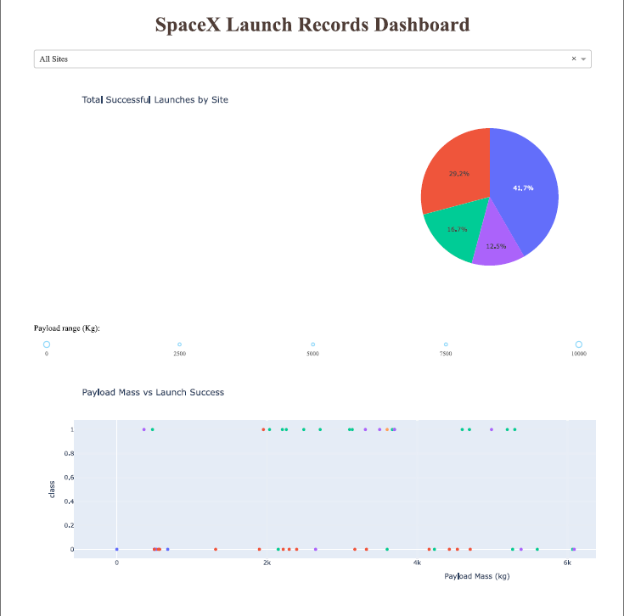
Results
LR, SVM, KNN are top-performing models for forecasting outcomes in this data.
Lighter payloads have a higher performance compared to heavier ones.
The likelihood of a SpaceX launch succeeding increases with the number of years of experience, suggesting a trend towards flawless launches over time.
Launch Complex 39A at Kennedy Space Center has the highest number of successful launches compared to other launch sites.
GEO,HEO,SSO,ES L1 orbit types exhibit the highest rates of successful launches.
Github URL: spacex_launch_records_dashboard.pdf

Slide 20

Section 2

Slide 21
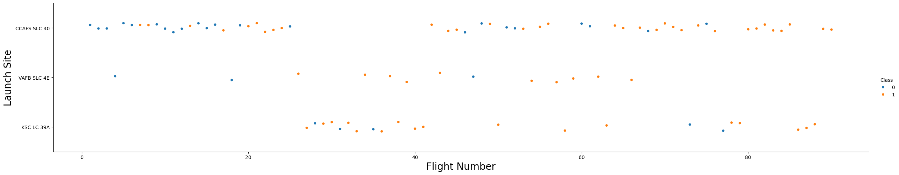
Flight Number vs. Launch Site
Total number of launches from launch site CCAFS SLC 40 are significantly higher than the other launch sites.

Slide 22
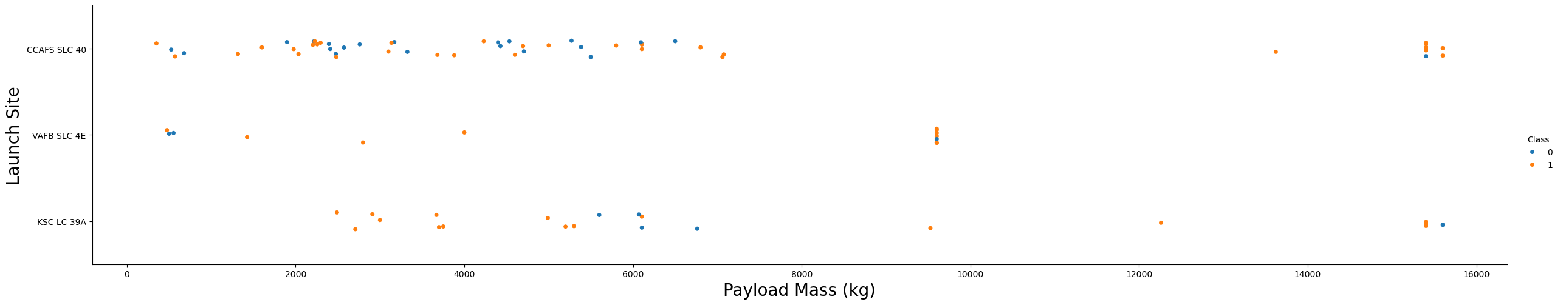
Payload vs. Launch Site
Payloads with lower mass are have more launches compared to those with higher mass across all three launch sites.

Slide 23
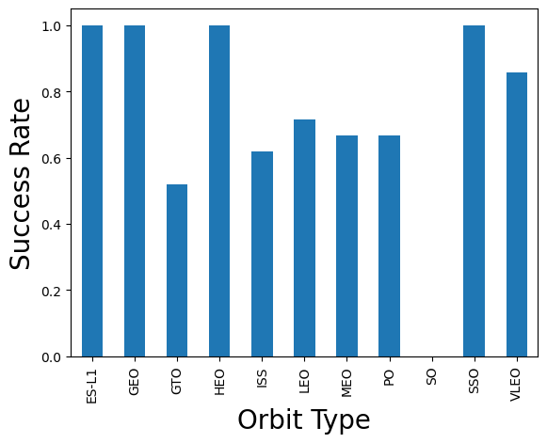
Success Rate vs. Orbit Type
Orbit types ES-L1, GEO, HEO, SSO have the highest success rate among all.

Slide 24
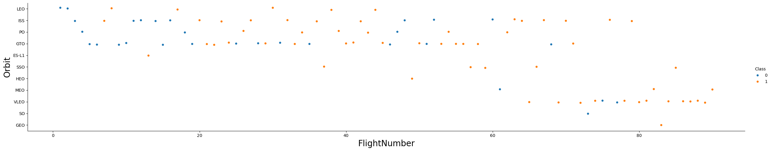
Flight Number vs. Orbit Type
LEO, ISS, PO, GTO orbits have the most launches in the earlier years, but it slowly shifted to VLEO orbit in the later years.

Slide 25
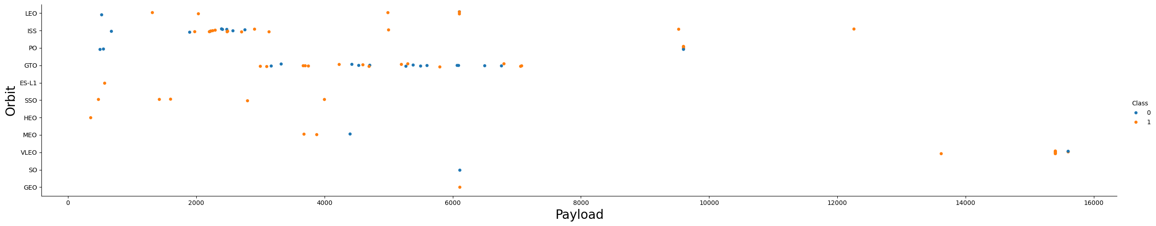
Payload vs. Orbit Type
Heavy payloads tend to have higher successful landing rates for PO, LEO, and ISS orbits, but for GTO orbit, success is less predictable with an almost equal mix of successes and failures.

Slide 26
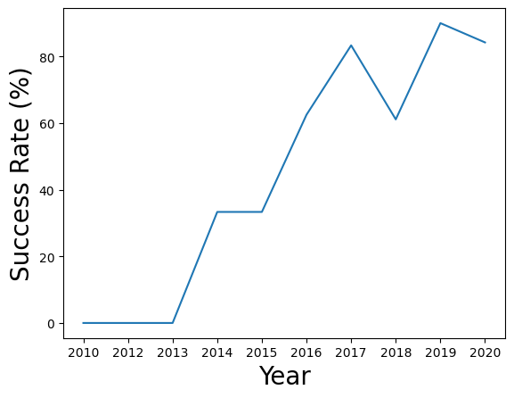
Launch Success Yearly Trend
The success rate of launches have been increasing since 2013 till 2020, possibly due to technology advancement and experience.

Slide 27
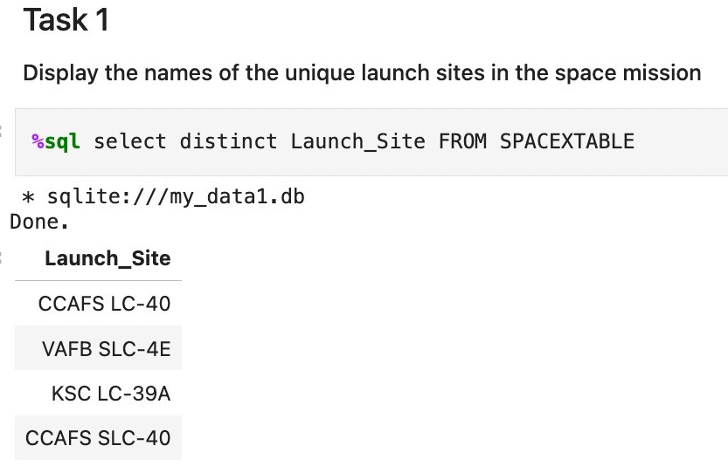
All Launch Site Names
Performed an SQL query to obtain all launch site names

Slide 28
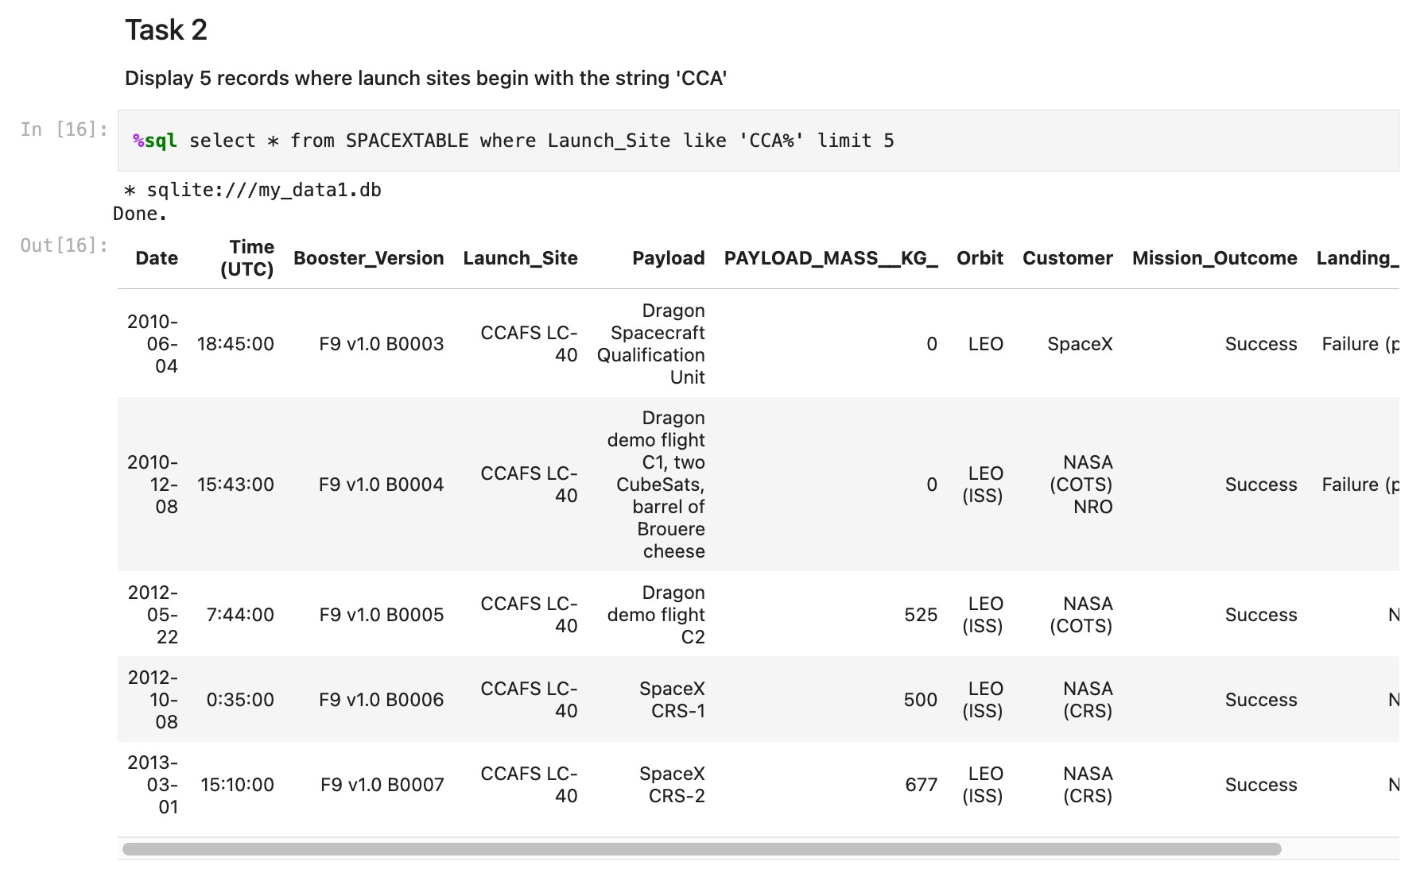
Launch Site Names Begin with 'CCA'
Performed an SQL query to obtain 5 launch site names that begin with ‘CCA’

Slide 29
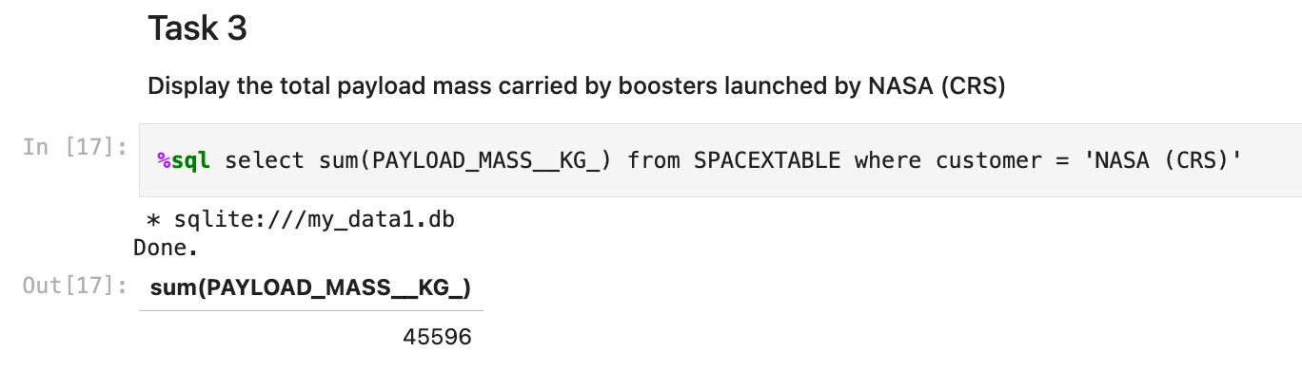
Total Payload Mass
Performed an SQL query to obtain the total payload mass carried by boosters launched by NASA (CRS)

Slide 30
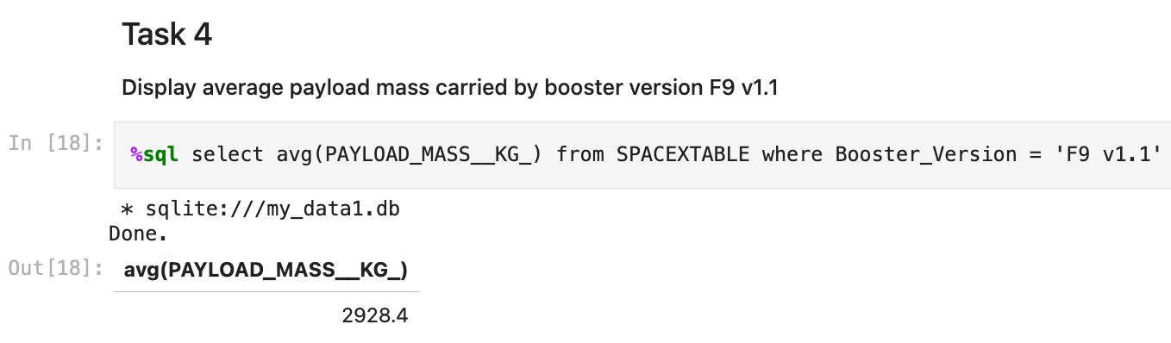
Average Payload Mass by F9 v1.1
Performed an SQL query to calculate the average payload mass carried by booster version F9 v1.1

Slide 31
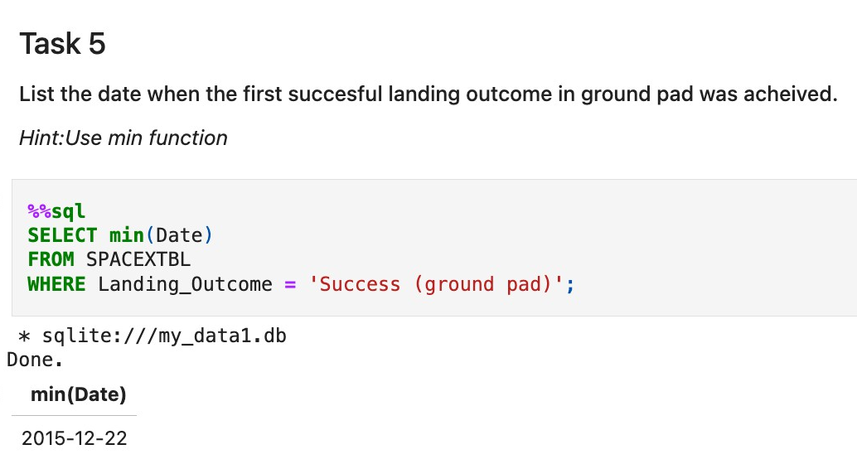
First Successful Ground Landing Date
Performed an SQL query to find the dates of the first successful landing outcome on ground pad

Slide 32
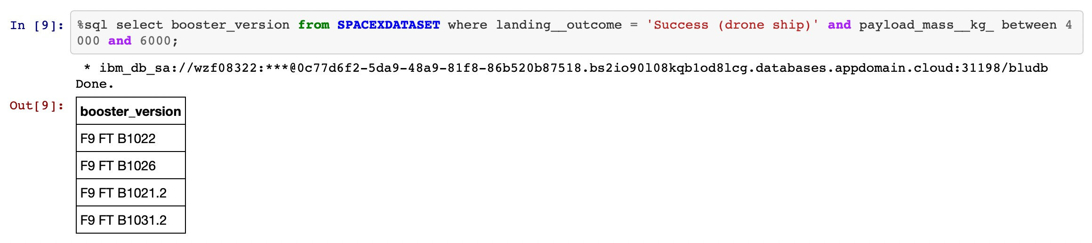
Successful Drone Ship Landing with Payload between 4000 and 6000
Performed an SQL query to list the names of boosters which have successfully landed on drone ship and had payload mass greater than 4000 but less than 6000

Slide 33
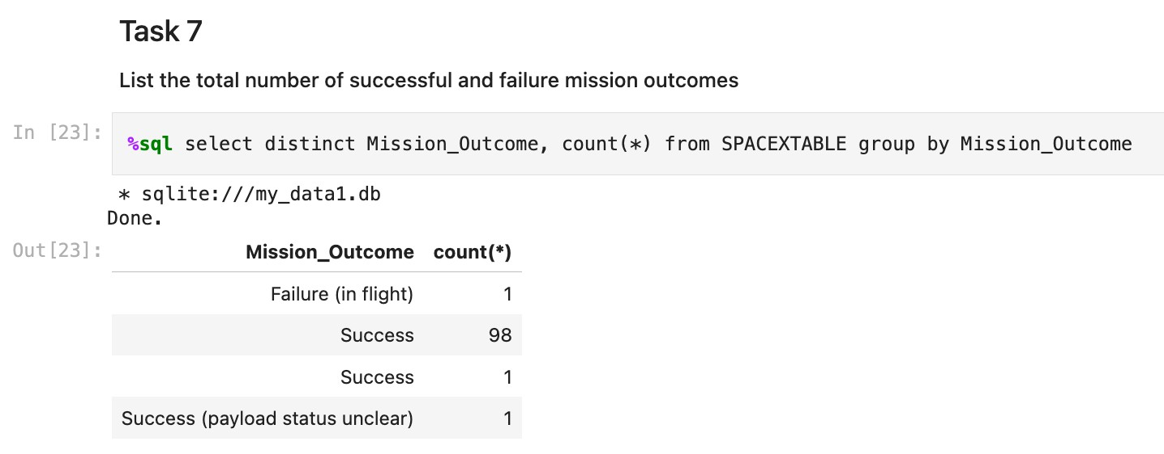
Total Number of Successful and Failure Mission Outcomes
Performed an SQL query to calculate the total number of successful and failure mission outcomes

Slide 34
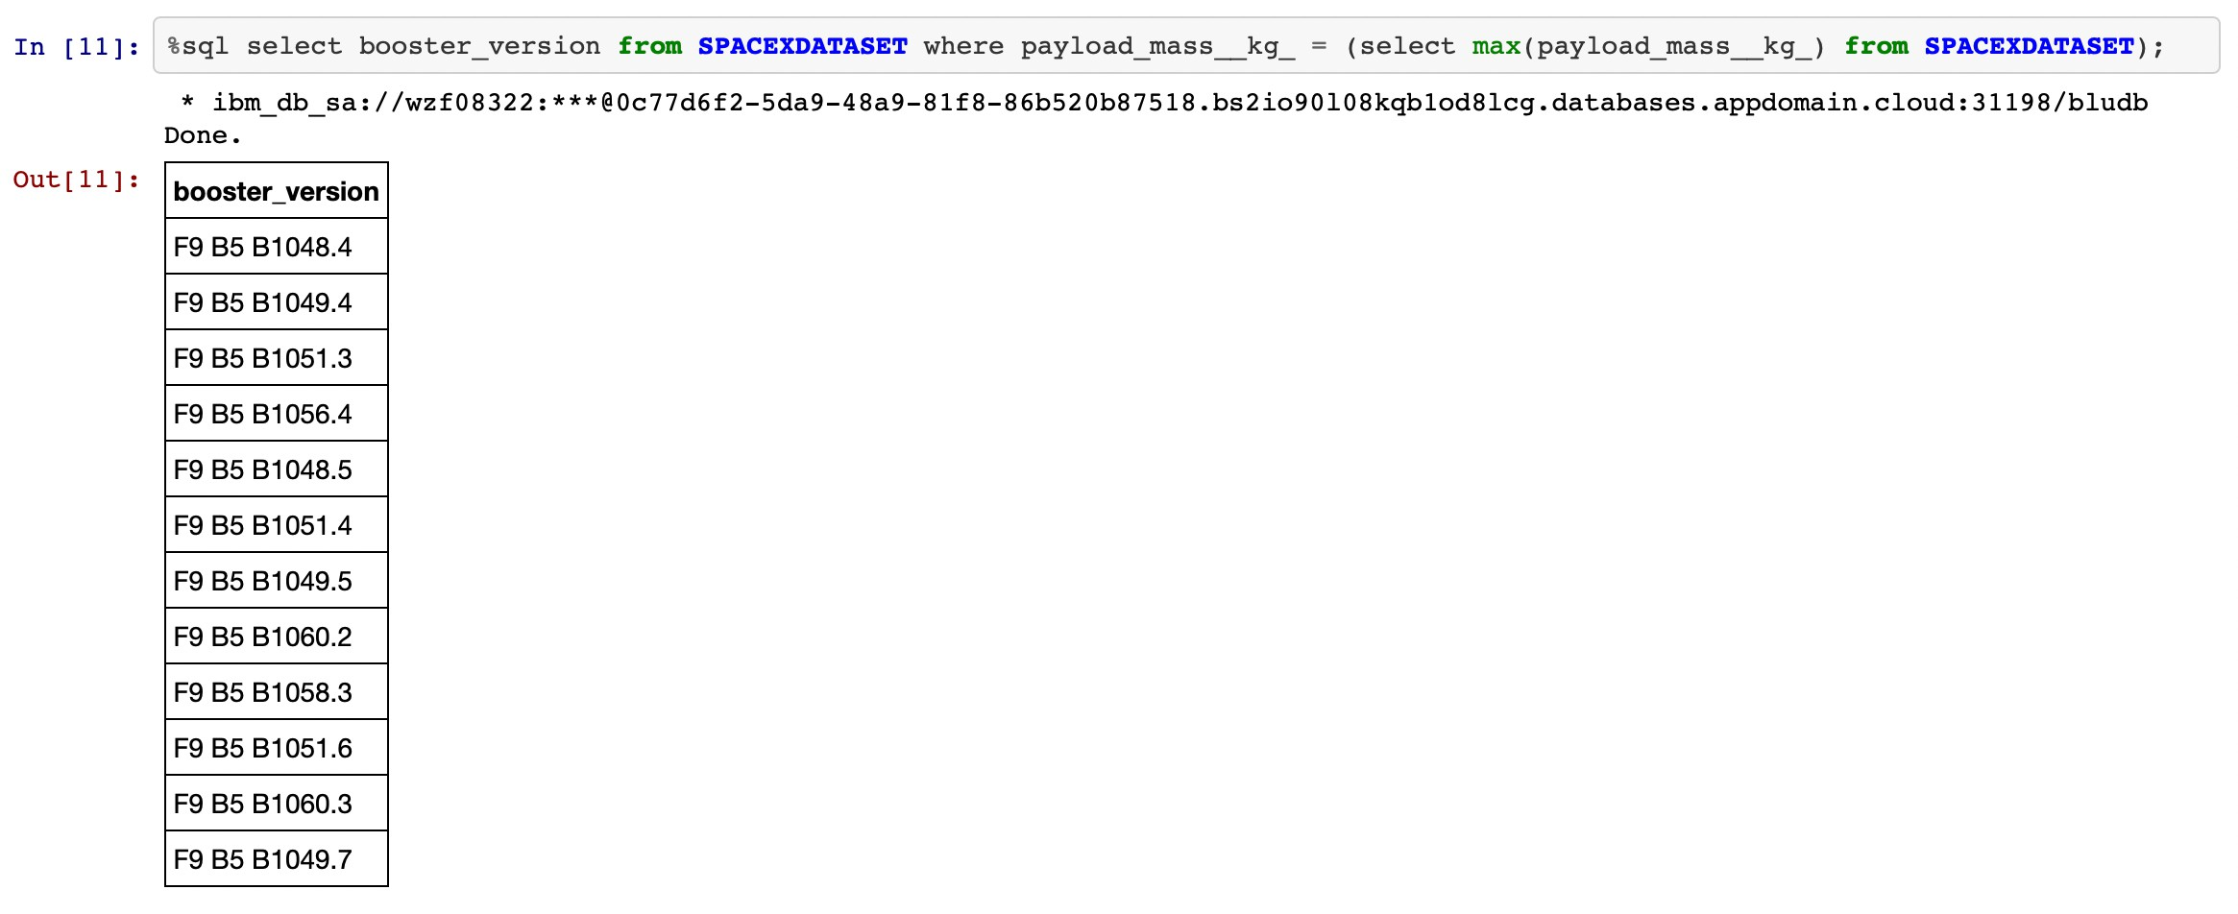
Boosters Carried Maximum Payload
Performed an SQL query to list the names of the booster which have carried the maximum payload mass

Slide 35
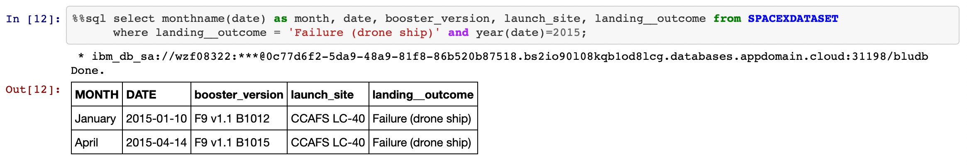
2015 Launch Records
Performed an SQL query to list the failed landing outcomes in drone ship, their booster versions, and launch site names for in year 2015

Slide 36
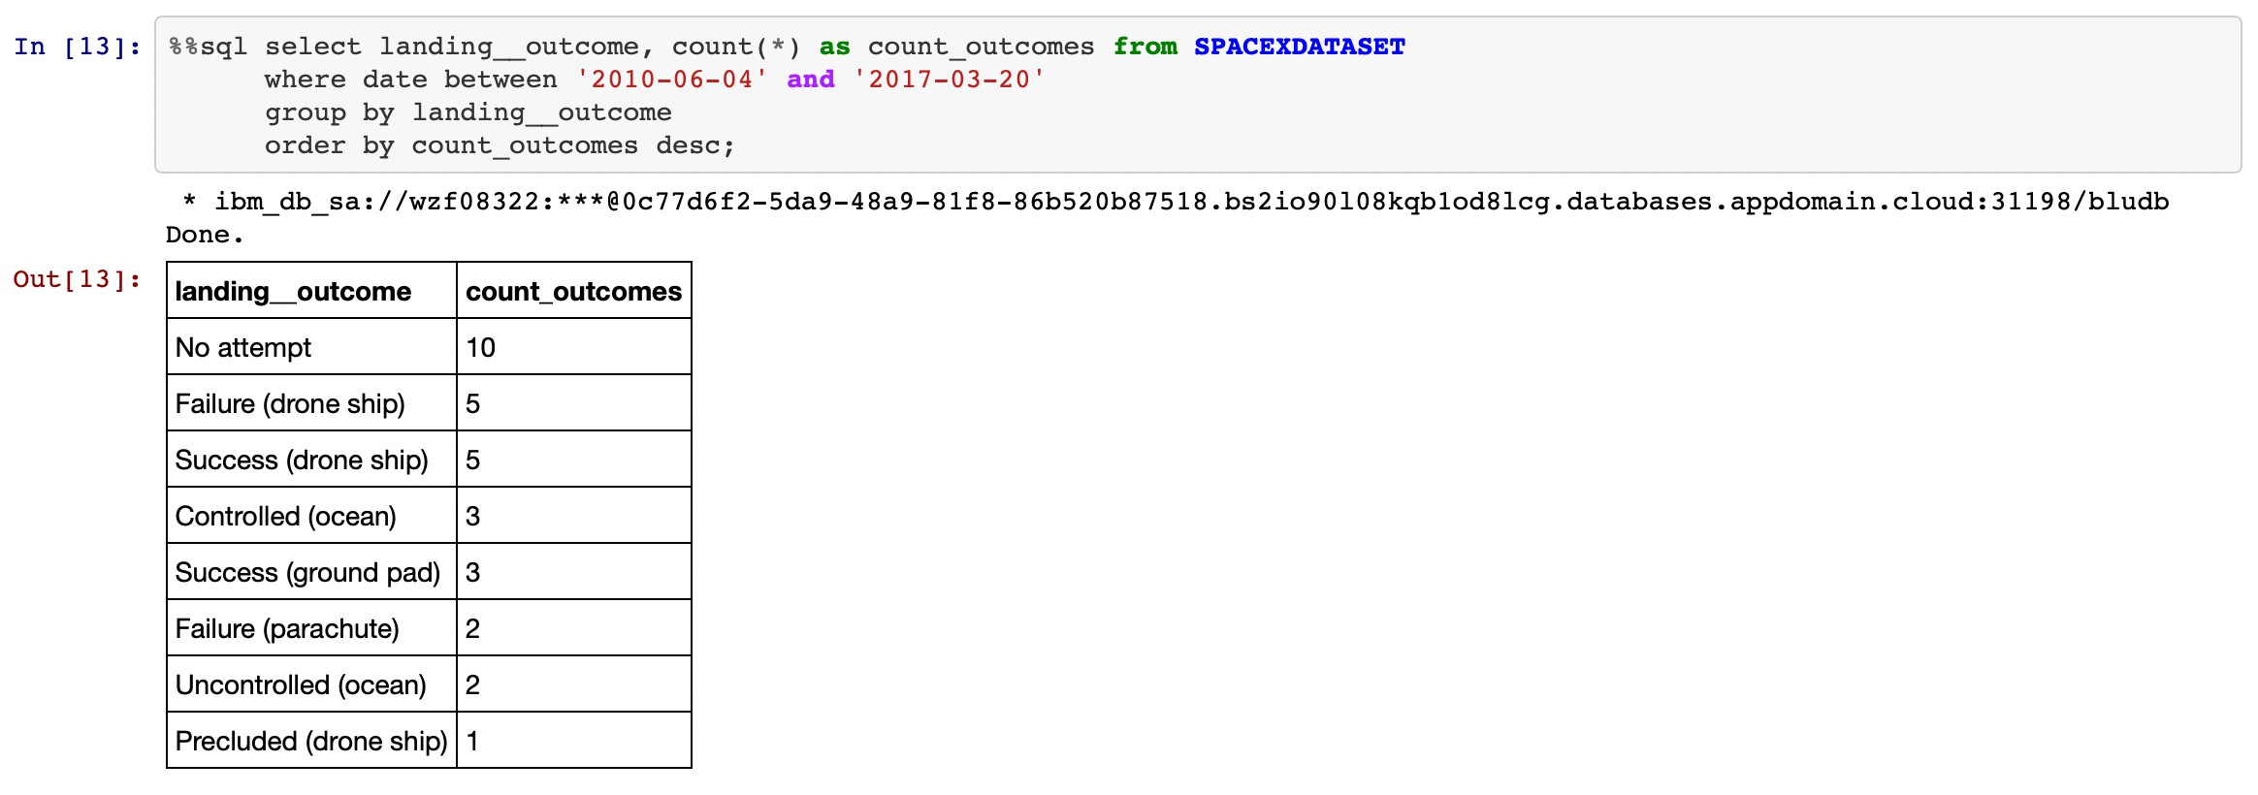
Rank Landing Outcomes Between 2010-06-04 and 2017-03-20
Performed an SQL query to rank the count of landing outcomes (such as Failure (drone ship) or Success (ground pad)) between the date 2010-06-04 and
2017-03-20, in descending order

Slide 37

Section 3

Slide 38
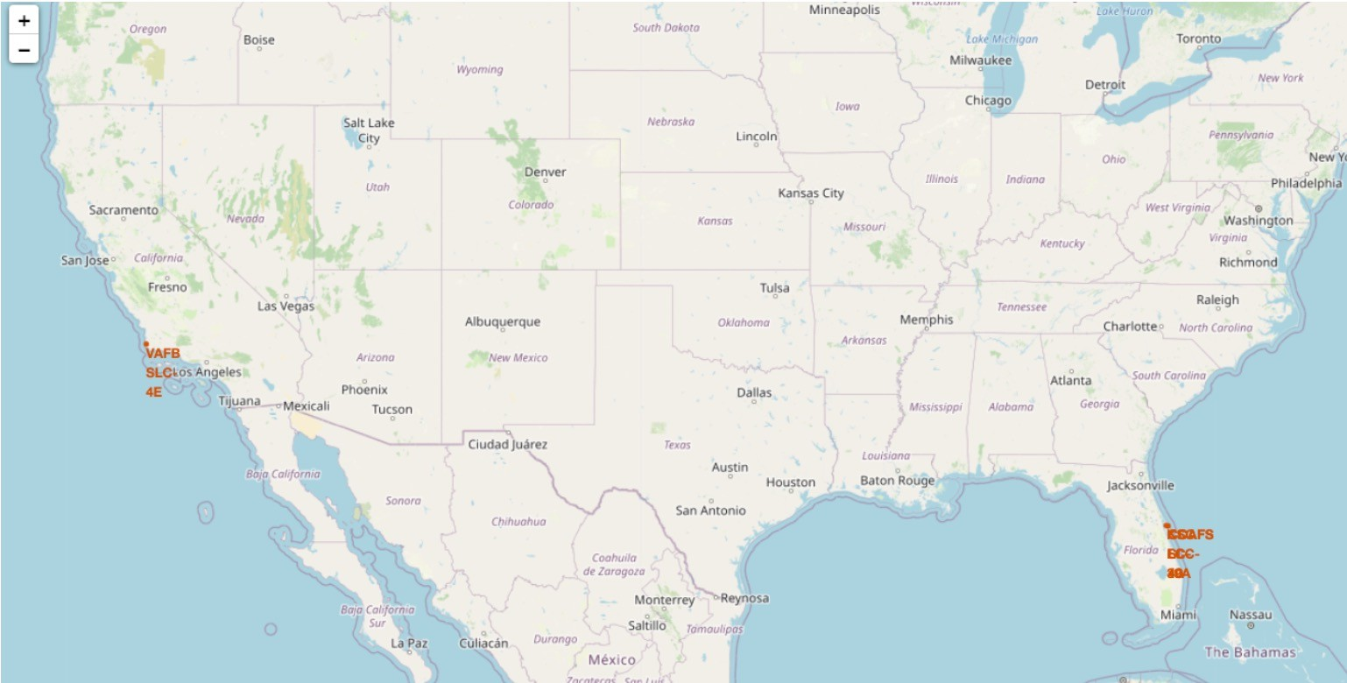
All launch sites on a map
The launch sites are labelled by a marker with their names on the map.

Slide 39
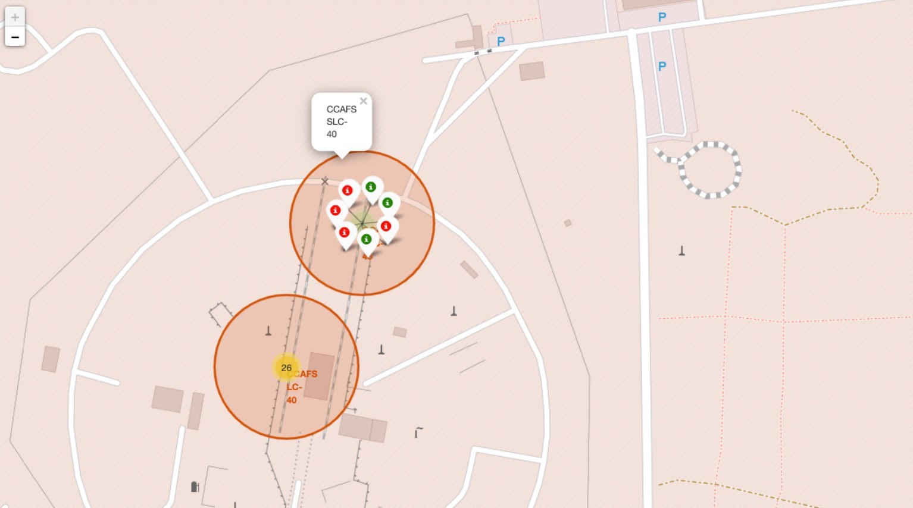
All success/failed launches for each site on the map
The launch records are grouped in clusters on the map, then labelled by green markers for successful launches, and red markers for unsuccessful ones.

Slide 40
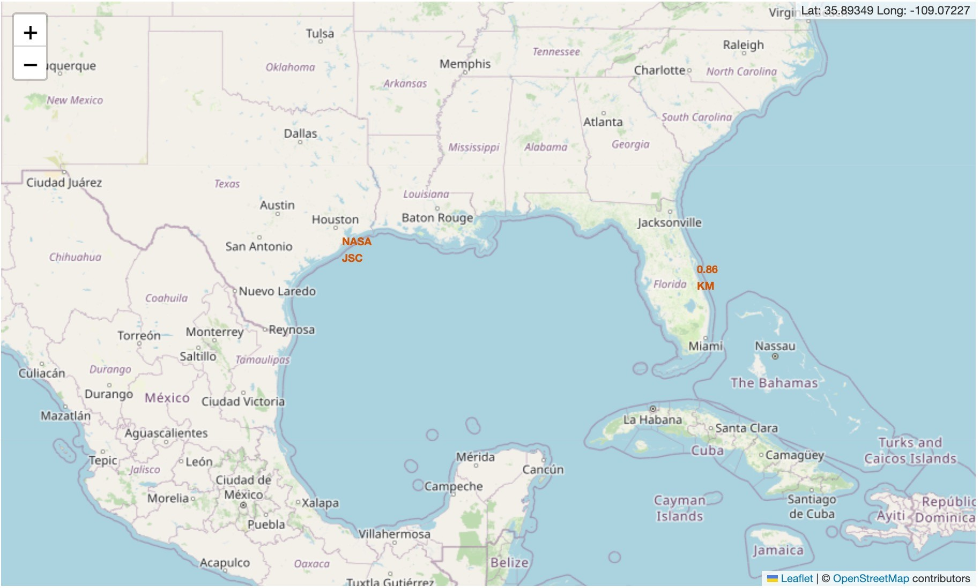
Distances between a launch site to its proximities
The closest coastline from NASA JSC is
marked as a
point using MousePosition and the distance between the coastline point and the launch site, which is approximately
0.86 km.

Slide 41

Section 4

Slide 42
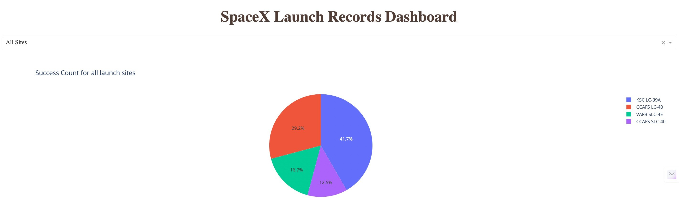
Total success launches for all sites
KSC LC-39A has the highest amount of success launches with 41.7% from the entire record, whereas CCAFS SLC-40 has the lowest amount of success launches with only 12.5%.

Slide 43
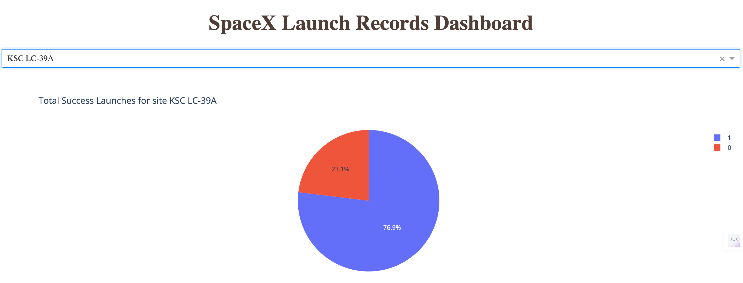
Success ratio of the launch site with the highest success launches
KSC LC-39A which is the launch site with highest amount of success, has a 76.9% success rate for the launches from its site, and 23.1% failure rate.

Slide 44
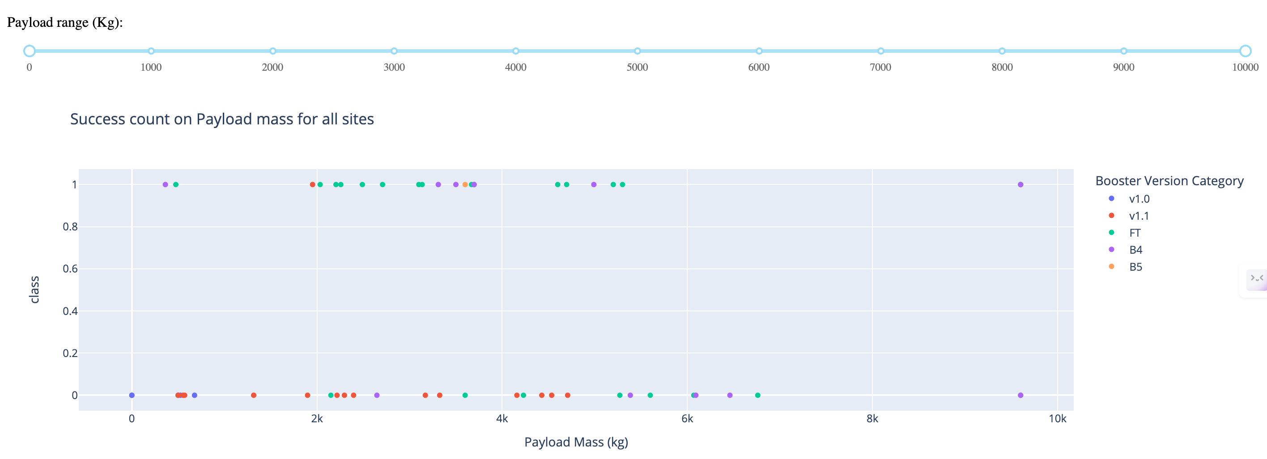
Payload vs. launch outcome
The payload range that has the highest success launches is between 2,000 to 4,000 kg, which can be seen by the most number of plots in that range, followed by the payload range of 4,000 to 6,000 kg, with the second most number of plots.
Booster version FT (green spots) has the highest success launches, followed by B4 (purple spots) with the second highest success launches, among all booster versions.

Slide 45

Section 5

Slide 46
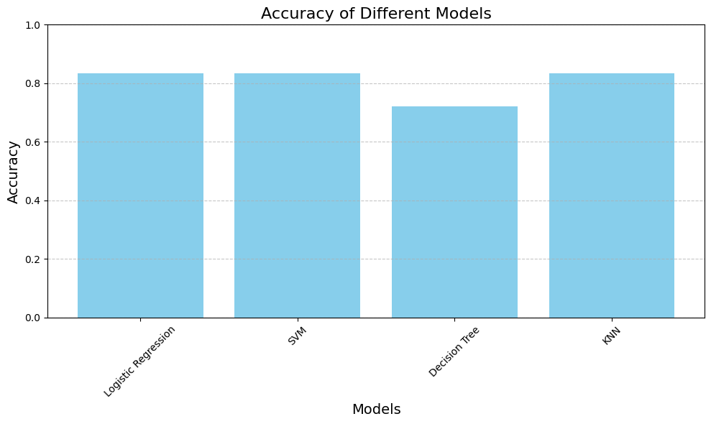
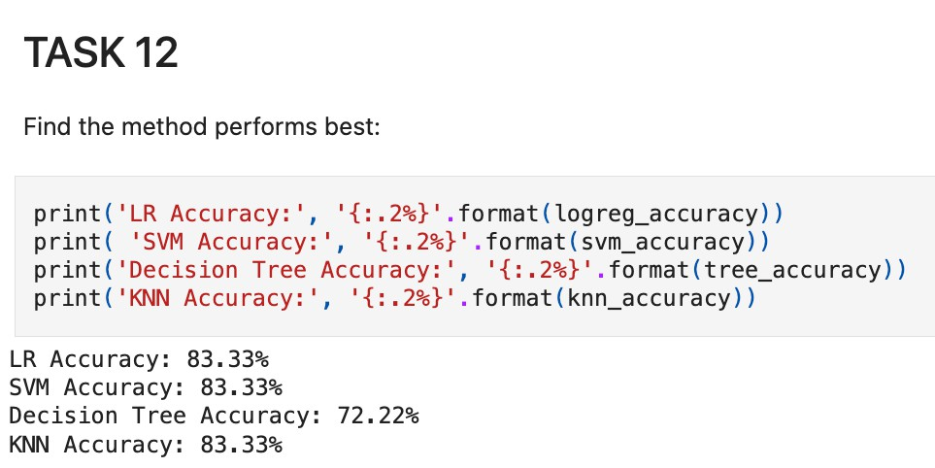
Classification Accuracy
The model that performed best are LR, SVM, KNN where all 3 achieved the highest accuracy of 83.33%.

Slide 47

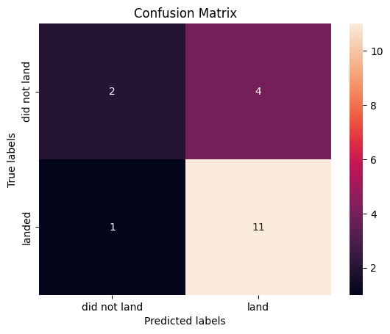
Confusion Matrix
Confusion Matrix of LR
Confusion Matrix of SVM
LR, SVM, KNN models are good as their confusion matrix show that they predicted all 12 successful landing correctly, with 0 error.
However, the Decision Tree model only predicted 11 successful landing correctly, with one of them wrongly predicted as a failed / did not land.
LR, SVM, KNN models have the same accuracy of 83.33% as displayed earlier, hence the same confusion matrix.
Confusion Matrix of Decision Tree
Confusion Matrix of KNN

Slide 48
Conclusions
Decision Tree Model is the best algorithm for this dataset.
Launches with a low payload mass show better results than launches with a larger payload mass.
Most of launch sites are in proximity to the Equator line and all the sites are in very close proximity to the coast.
The success rate of launches increases over the years.
KSC LC-39A has the highest success rate of the launches from all the sites.
Orbits ES-L1, GEO, HEO and SSO have 100% success rate.
KSC LC-39A has the most successful launches overall

Slide 49
Appendix
Git repository containing all the relevant assets like Python code snippets, SQL queries, charts, Notebook outputs, or data sets created during this project:
https://github.com/Reshma11K/Applied-Data-Science-Capstone

Slide 50


